Slide 1
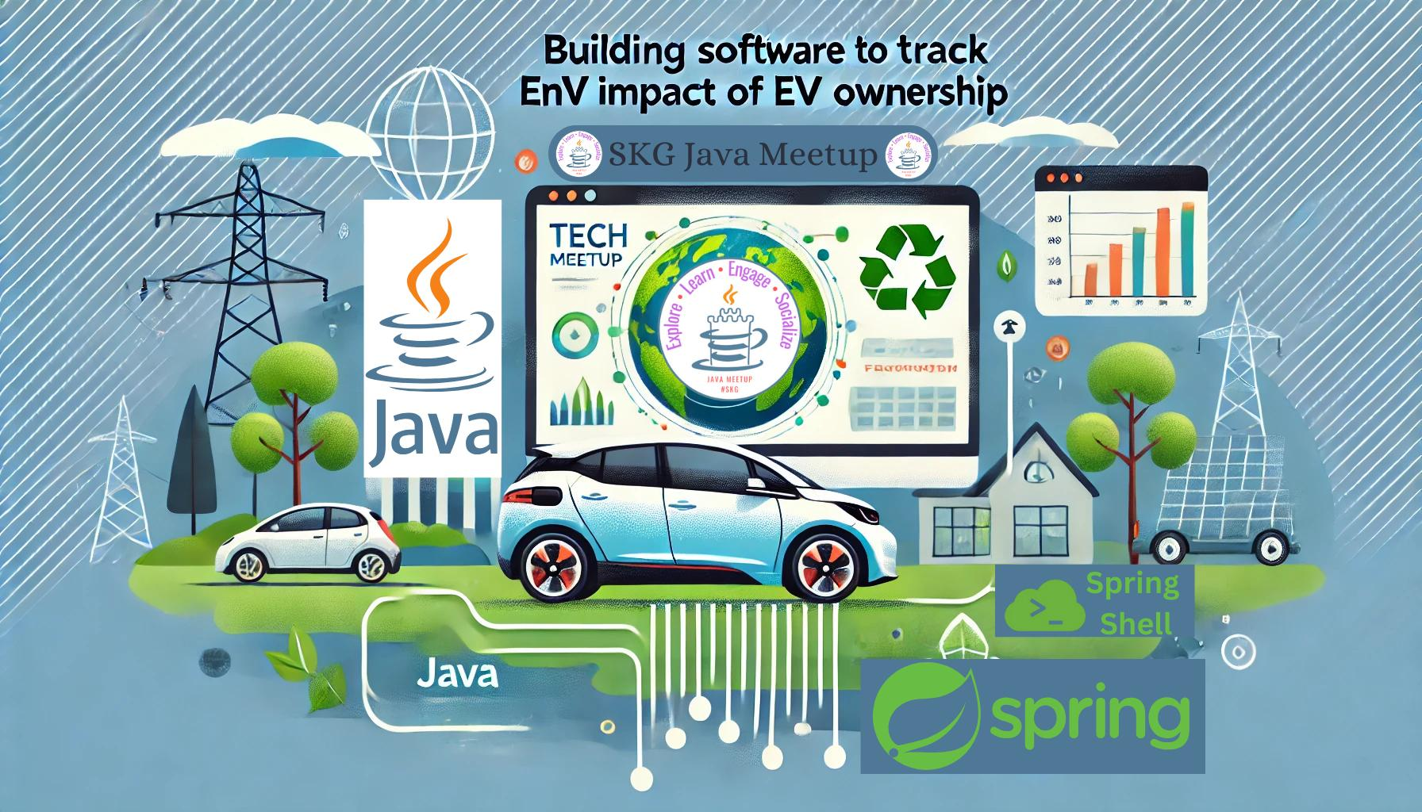
Giorgos Gaganis
Thessaloniki not-only Java Meetup - January 2025

Slide 2

Motivation, history, evolution and goals
Agenda
Intro to Spring Shell
What it measures and how it works
Live demo one year data
Q&A Living with a EV
01
02
03
04
05

Slide 3
Motivation, history, evolution and goals

Slide 4
Motivation/History
2011-2016
Global warming awareness
2016
Solar water heater project
2018
LPG conversion to my Seat Leon
2020
Increased car usage - Reevaluated my impact
Peugeot e2008 introduced to the Greek Market
Green electricity - Δικαιώματα προέλευσης
Ioannis Pregnancy

Slide 5
Motivation/History - Continued
2020 - 2023
Lack of choice - main hurdle body size :)
2021
Ipto analytics App introduced
2023
Introduction of the first chinese brand
Ordered MG4
2024
Received it

Slide 6
Goals
Have net positive impact on my co2 emissions
Have concrete data to evaluate this
Need for change
Evaluate my binary decision for environment & ownership
Keep Leon LPG or buy an EV

Slide 7
Intro to Spring Shell

Slide 8
What is Spring Sell?
Spring framework component/library for command line appliations
It allowed me to very quickly be able to interact with my application
Has been a great find that I have been using also at work

Slide 9
Spring Shell - Live Coding

Slide 10
What it measures and how it works

Slide 11
Domain
EVs “refuel” through charging, consuming electricity from the Hellenic Transmission System(grid)
The grid provides this consumed electricity through production
This production causes co2 emissions
This production is documented both annually & hourly eg

Slide 12
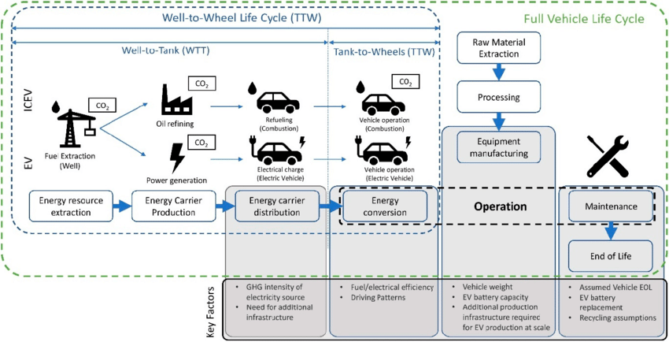
How it works and what it measures
Image source: https://www.researchgate.net/figure/llustration-of-a-vehicle-life-cycle-adapted-from-5-6_fig1_345766650

Slide 13
Capture what are the co2 emission for each hour - co2-gatherer
Capture which hours charge - power-per-hour

Slide 14
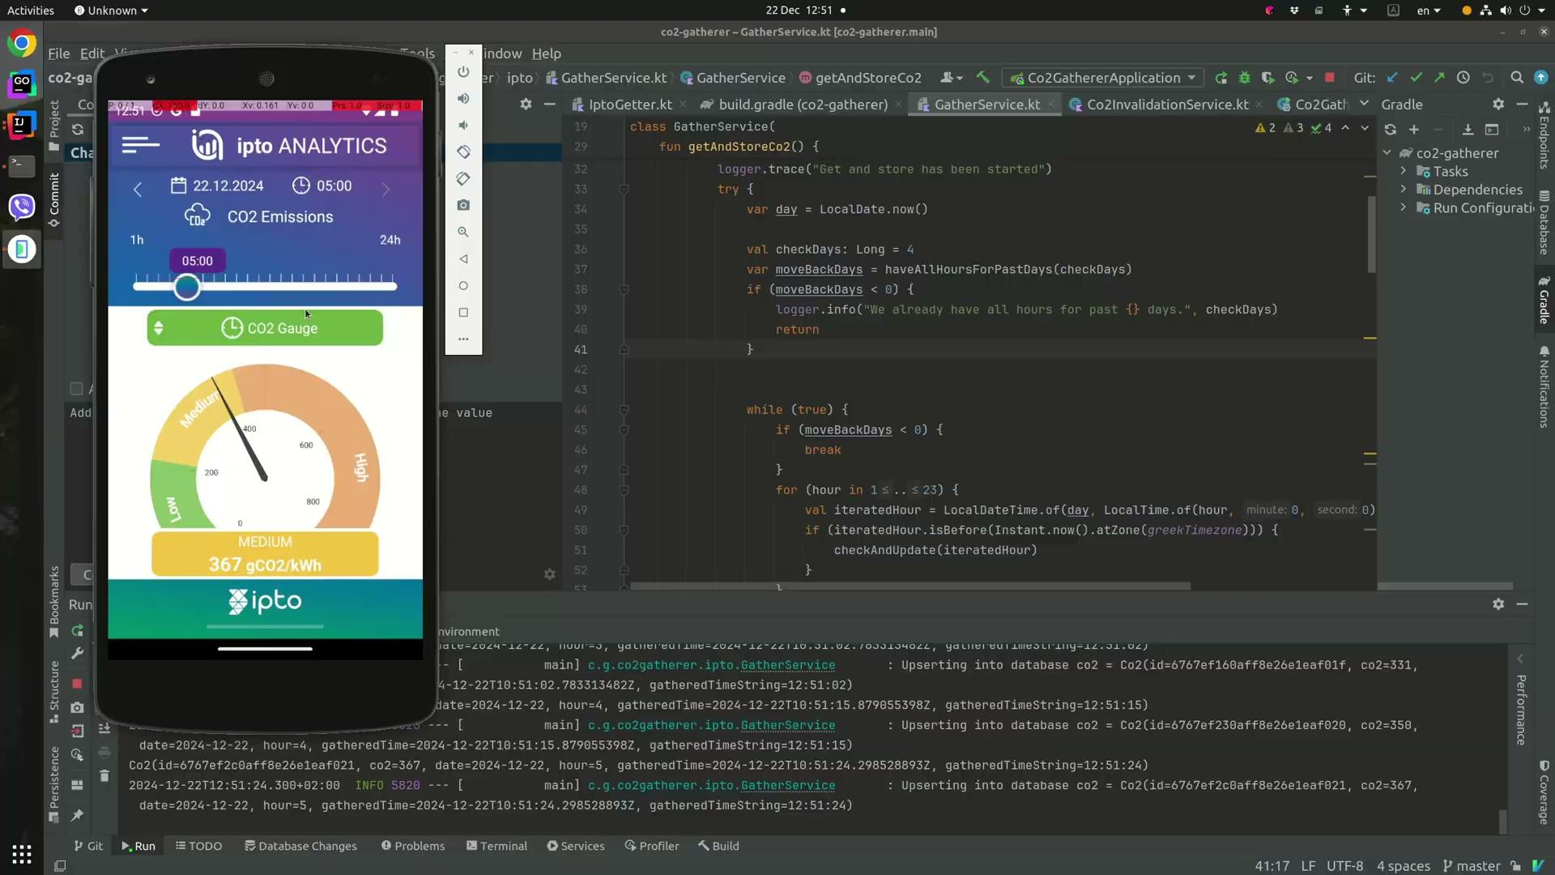
co2-gatherer operation video

Slide 15
Live demo one year data

Slide 16
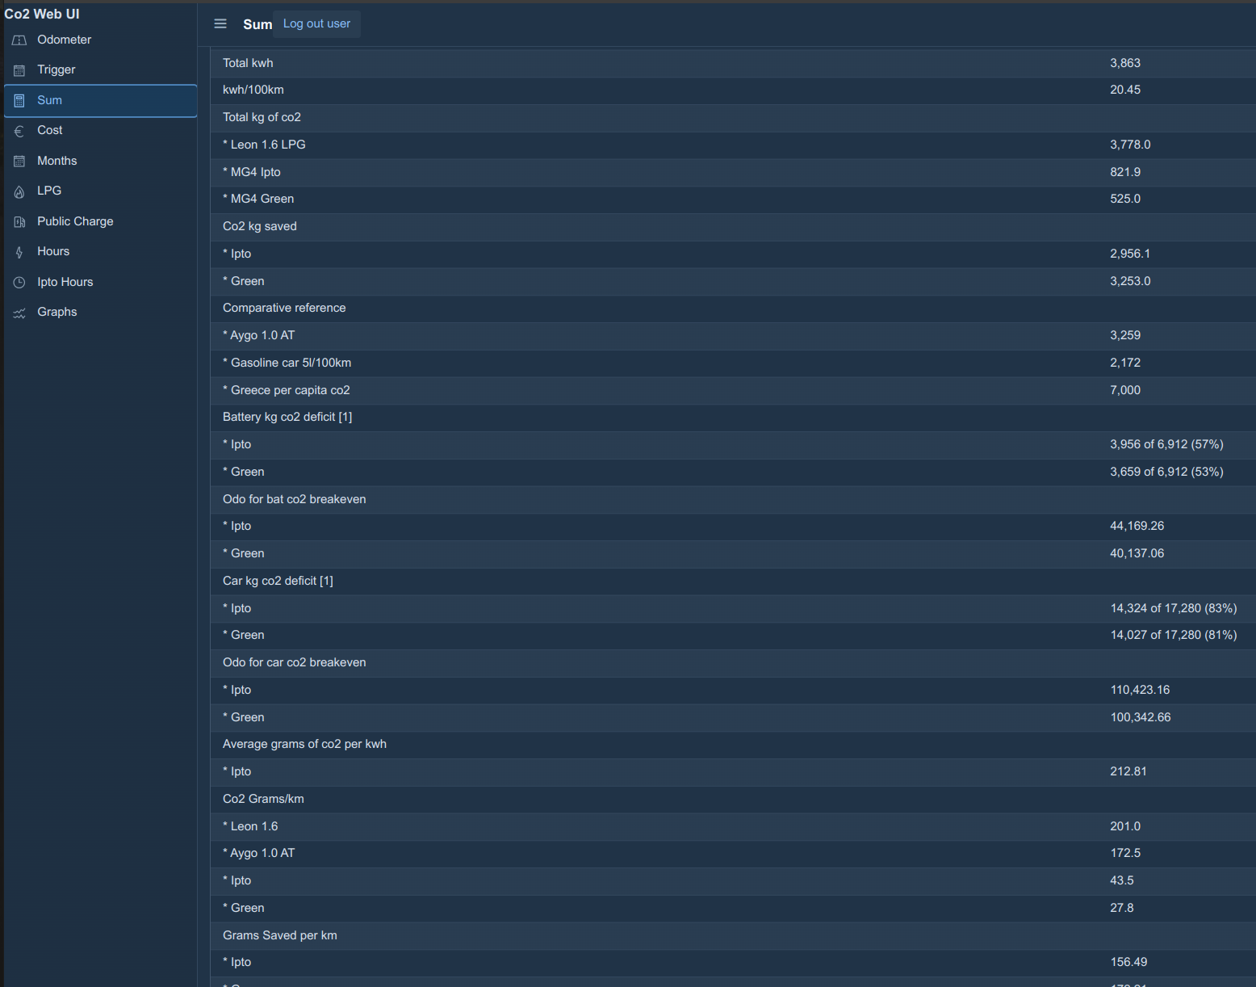

Slide 17
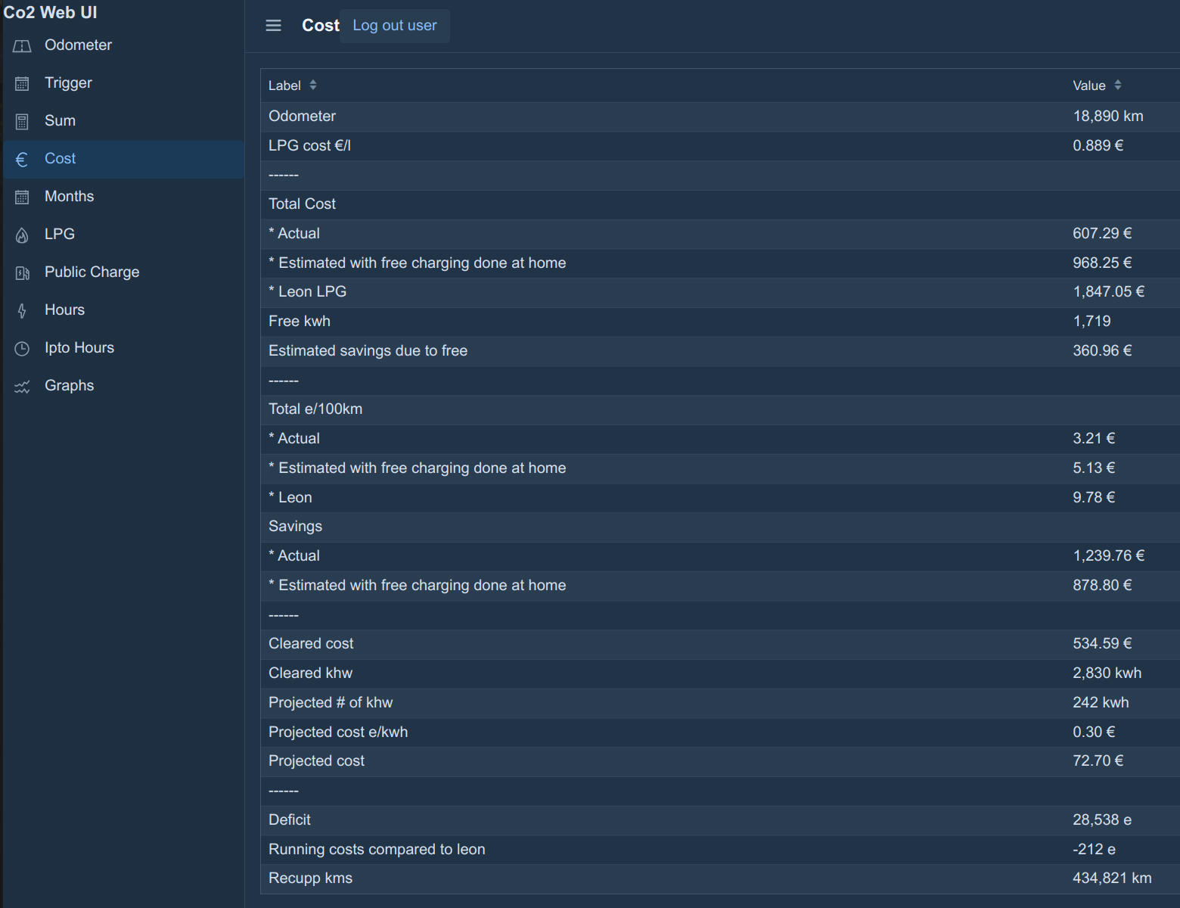

Slide 18
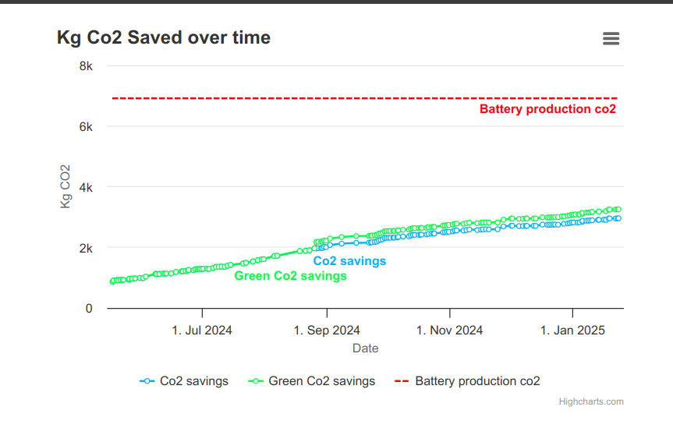

Slide 19
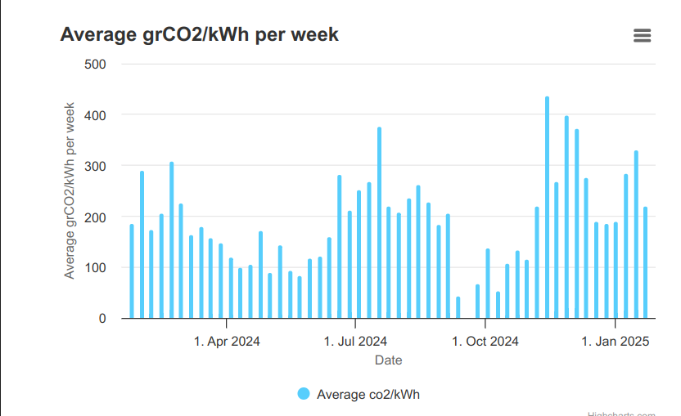

Slide 20
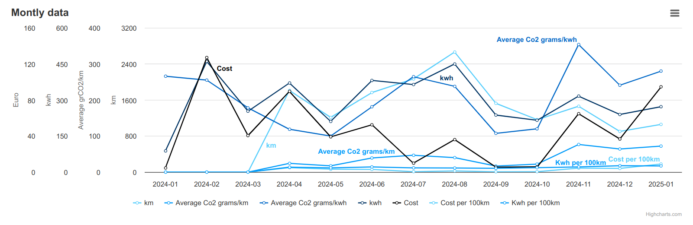

Slide 21
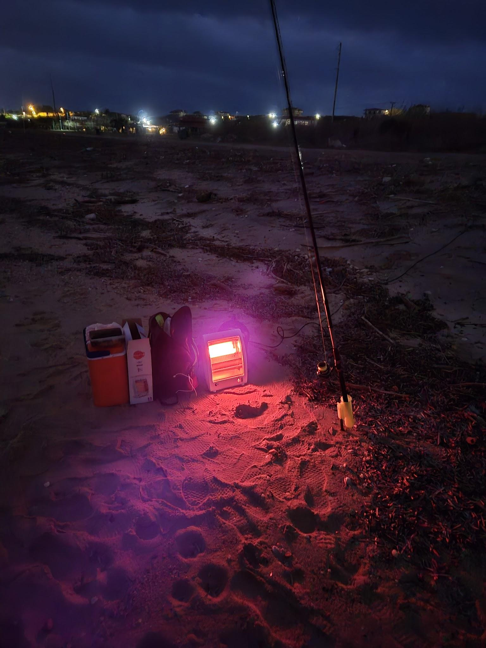
Q&A Living with a EV

